Slide 1
TEAM NAME : SPARTANS
COLLAGE NAME : AMRITA SCHOOL OF ENGINEERING
TEAM MEMBERS : THARSHANANTH N
: ANURID G K : SREYAS S K

Slide 2



Problem statement
AI FOR SOCIAL GOOD
"Elevate social impact: AI empowers startups with sustainable growth strategies"

Slide 3


"Developing AI algorithms to predict product demand and supply, empowering businesses and consumers to anticipate price fluctuations and product availability with greater accuracy "
SOLUTION

Slide 4
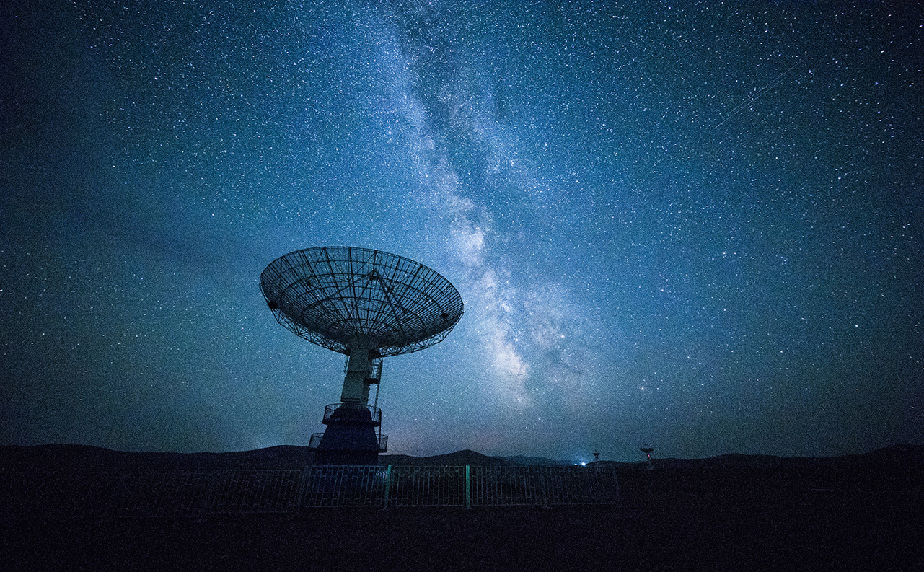
Project major requirement
Numpy
Pandas
Matplotlib
Seaborn
Beautiful soup
Requests
HTML
CSS
Java script
Django python

Slide 5
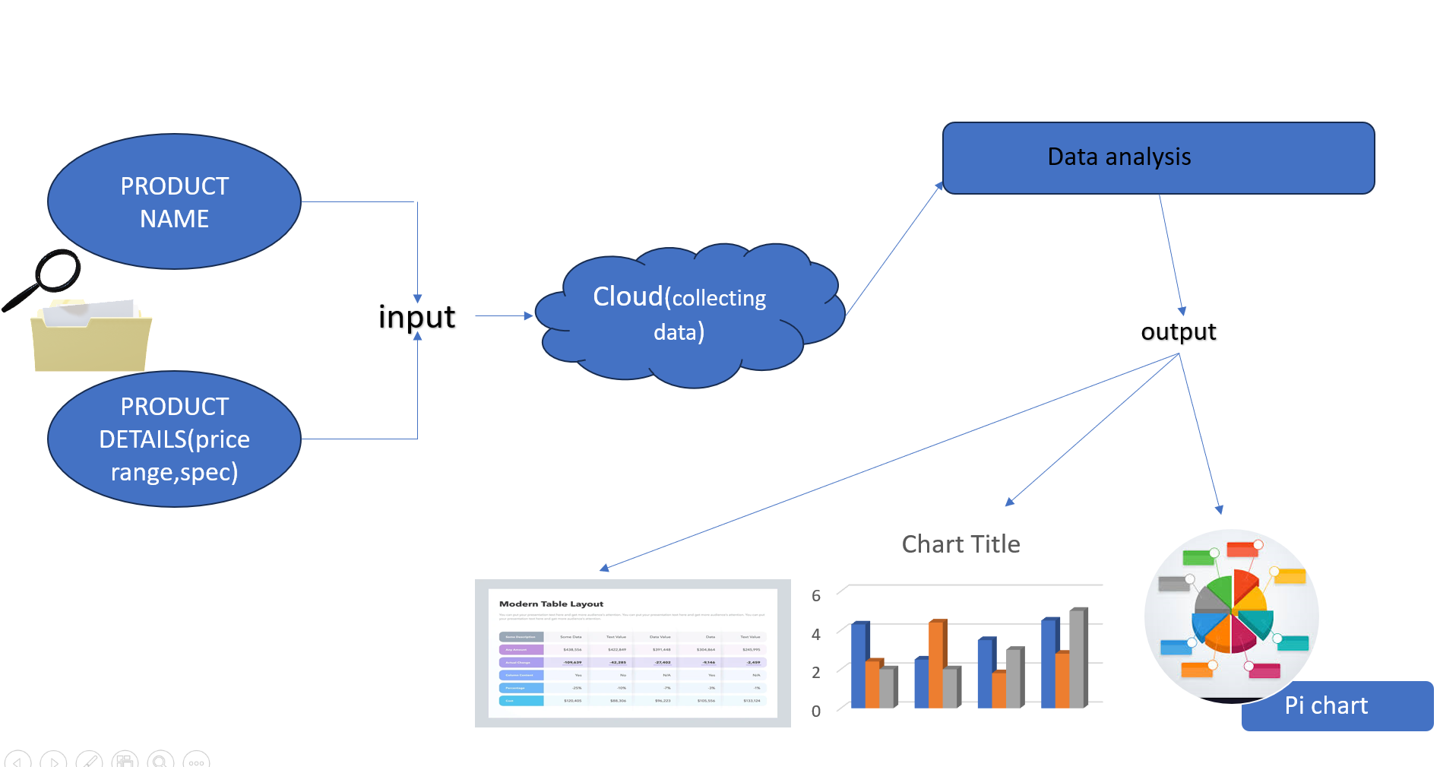
Features &outcome
1.Advanced Predictive Analytics
2.Real-Time Data Processing
3.Customizable Models
4.User-Friendly Interface
5.Integration Capabilities

Slide 6
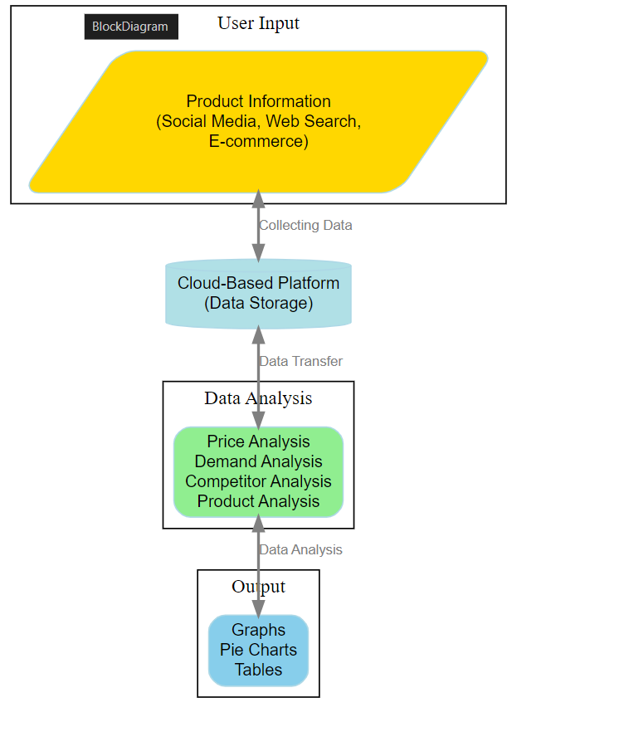
BLOCK DIAGRAM& FLOWCHART

Slide 7
Thank you

